Slide 1



Heart attack risk insights,
powered by AI
Tkachenko Ekaterina
Dolzhenkova Darya
Baltabayeva Aruzhan
Issaliyev Maxat
Shabanau Dzmitry

Slide 2

Motivation
The Problem
Heart disease is the leading cause of death globally, yet early warning signs often go unnoticed. Traditional risk assessment requires clinical visits, making prevention inaccessible for many.
Target Audience
Individuals concerned about heart health, patients with risk factors like high blood pressure or diabetes, and doctors seeking quick screening tools for early intervention.
Our Solution
CardioGuard delivers instant, AI-powered risk scores with clear explanations of contributing factors, making heart health assessment fast, accessible, and actionable.

Slide 3











Overview
From metrics to action in minutes
Phase 1 – Landing Page
Introduction, key stats, how it works, and FAQ
Phase 2 – Authorization
Secure login and registration for patients and doctors
Phase 3 – Patients Page
Input health metrics, view risk score, and track history
Phase 4 – Doctors Page
Monitor patients, review assessments, and manage care

Slide 4
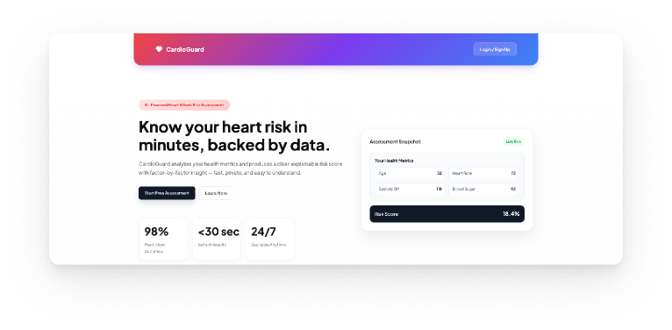
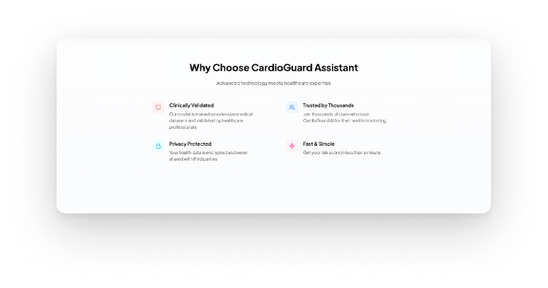
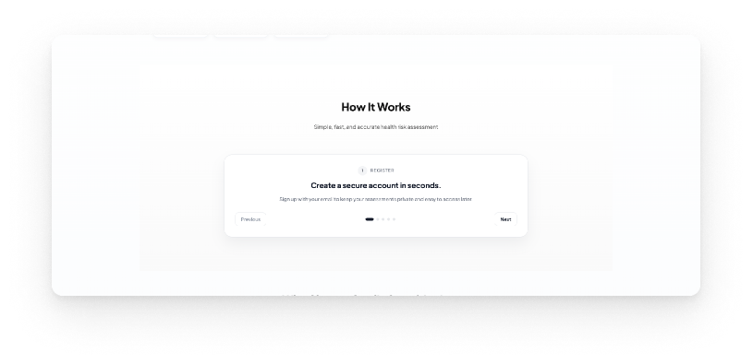
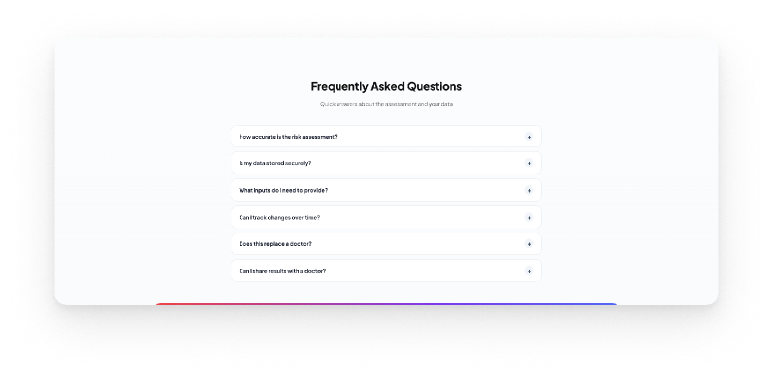
CardioGuard
Landing Page
This Page consists of several features
Hero Section
Why Choose CardioGuard
Process Slider
FAQ Accordion

Slide 5
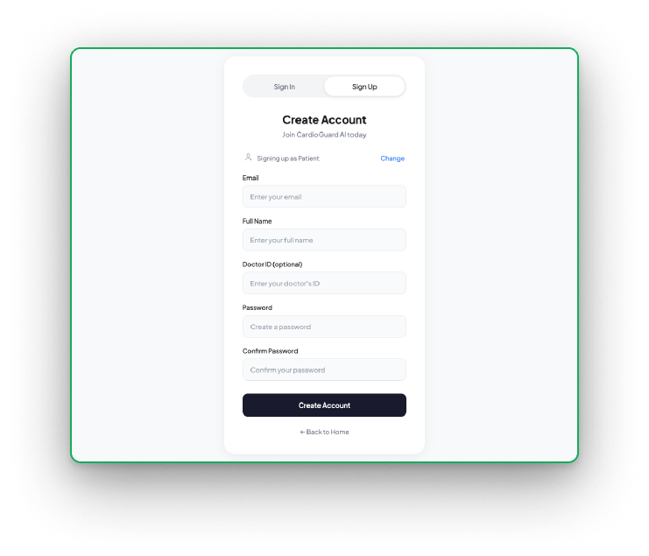
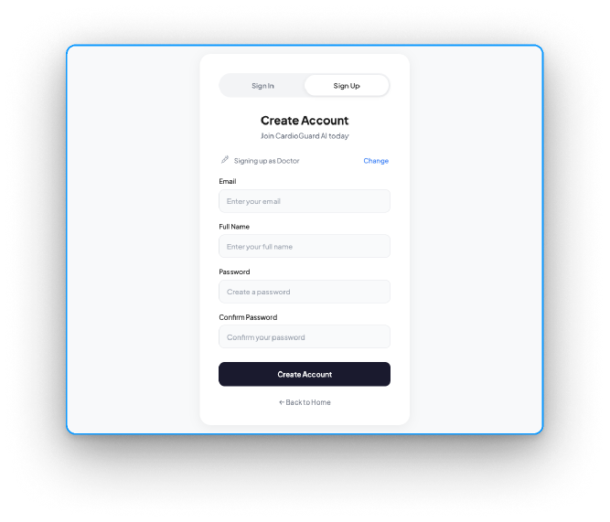
CardioGuard
Authorization
Different roles
Users can sign in or sign up as either a patient or a doctor, each with tailored dashboard access.
Hashing
User credentials are stored securely in the database. Passwords are automatically hashed by Django and verified against the stored hash during login.
Tokens
Access tokens are valid for 15 minutes; refresh tokens last 1 day. Every API request is authenticated by validating the access token.
9

Slide 6
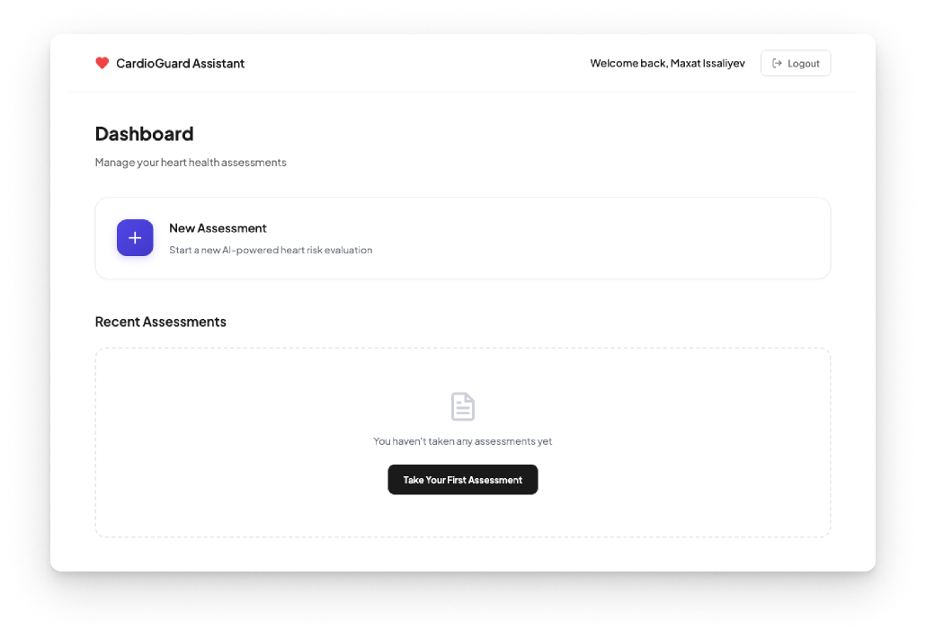
CardioGuard
Patients Page
Features available for patients
View all your previous assessments stored in your account
Complete an assessment by filling out 6 mandatory and 2 optional fields
After submitting, receive a detailed results page showing your risk percentage, factor-by-factor breakdown, and progress over time

Slide 7
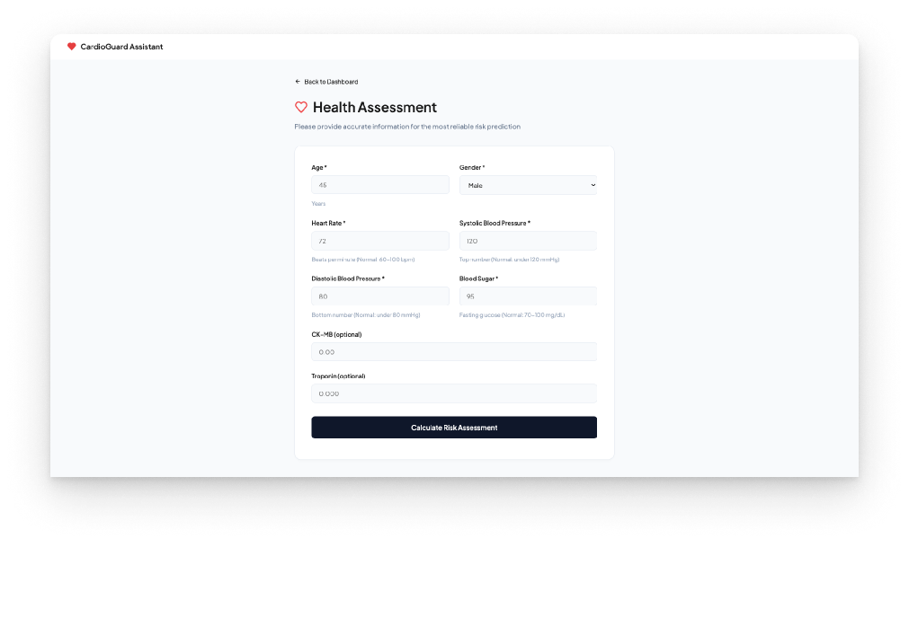
CardioGuard
Patients Page
Features available for patients
View all your previous assessments stored in your account
Complete an assessment by filling out 6 mandatory and 2 optional fields
After submitting, receive a detailed results page showing your risk percentage, factor-by-factor breakdown, and progress over time

Slide 8
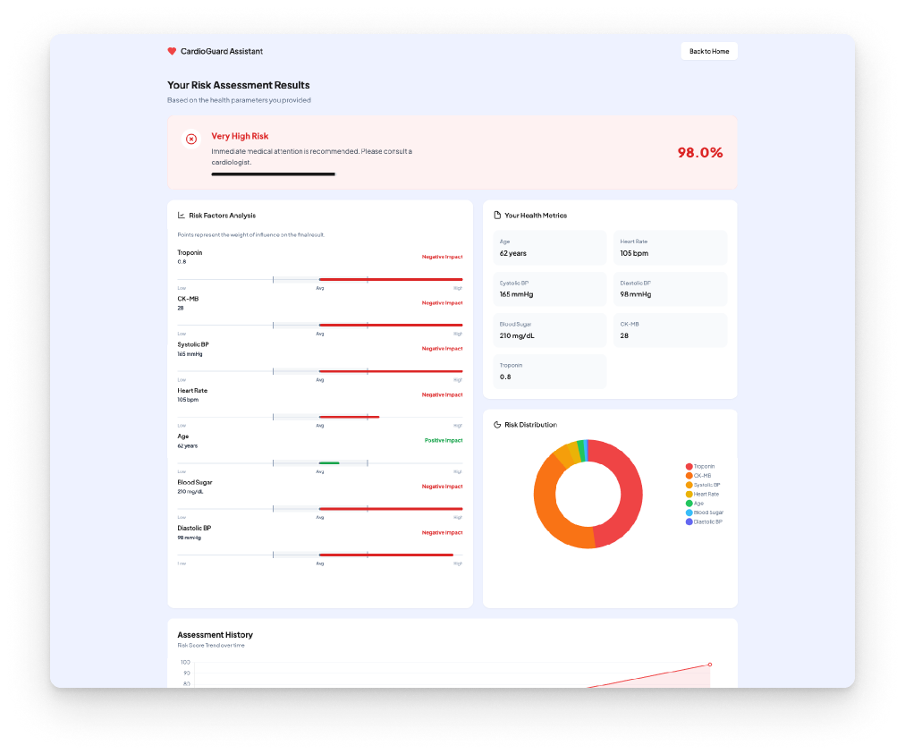
CardioGuard
Patients Page
Features available for patients
View all your previous assessments stored in your account
Complete an assessment by filling out 6 mandatory and 2 optional fields
After submitting, receive a detailed results page showing your risk percentage, factor-by-factor breakdown, and progress over time

Slide 9
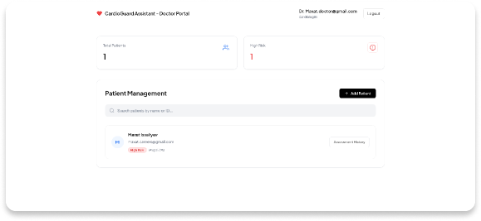
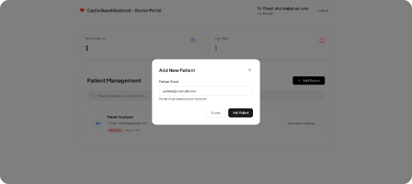
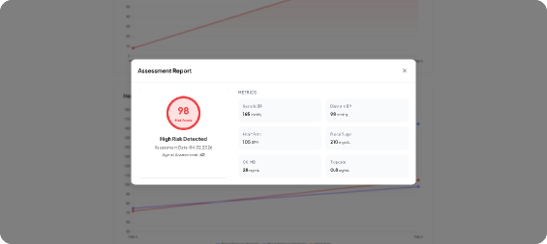
CardioGuard
Doctors Page
Doctors Portal
Add Patients
View Assessments
Centralized patient management
Register new patients quickly
Access detailed risk reports
View all your assigned patients, track their risk status, and access their assessment history—all from one dashboard.
Add patients to the system by entering their basic details. Once added, they appear in your management list for ongoing monitoring.
Review each patient's assessment results, including risk percentage, contributing factors, and health metric breakdown.

Slide 10
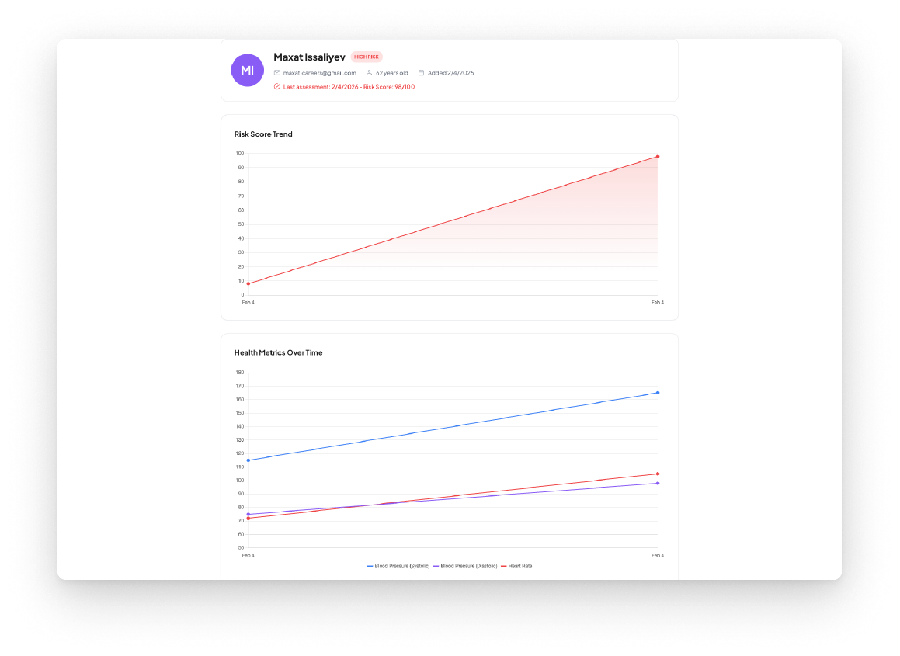
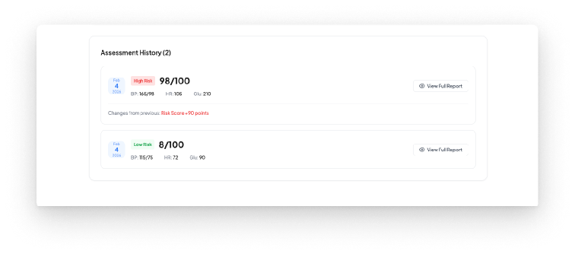
CardioGuard
Doctors Page
Patient Analysis
Comprehensive health tracking
Access each patient's detailed history: visualize risk score trends, monitor key health metrics (blood pressure, heart rate), and review all past assessments with score comparisons.

Slide 11
Technology
Backend
Frontend
Django
HTML / CSS / JavaScript
Python web framework for handling routing, templates, and server logic
User interface without external frameworks
Django REST Framework
Chart.js
Building RESTful APIs for frontend-backend communication
Interactive charts for risk trends and health metrics
SQLite
LocalStorage
Lightweight database for storing users, patients, and assessments
Storing JWT tokens for persistent authentication
Simple JWT
Google Fonts
Token-based authentication with access/refresh token flow
Typography (Plus Jakarta Sans)
Machine Learning
Data
Scikit-learn
Kaggle Medical Dataset
Random Forest Classifier for heart risk prediction
Training data for the heart disease prediction model
SHAP
Explainable AI—shows how each health metric contributes to the risk score
Pandas / NumPy
Data processing and numerical computations
Joblib
Saving and loading trained ML models

Slide 12
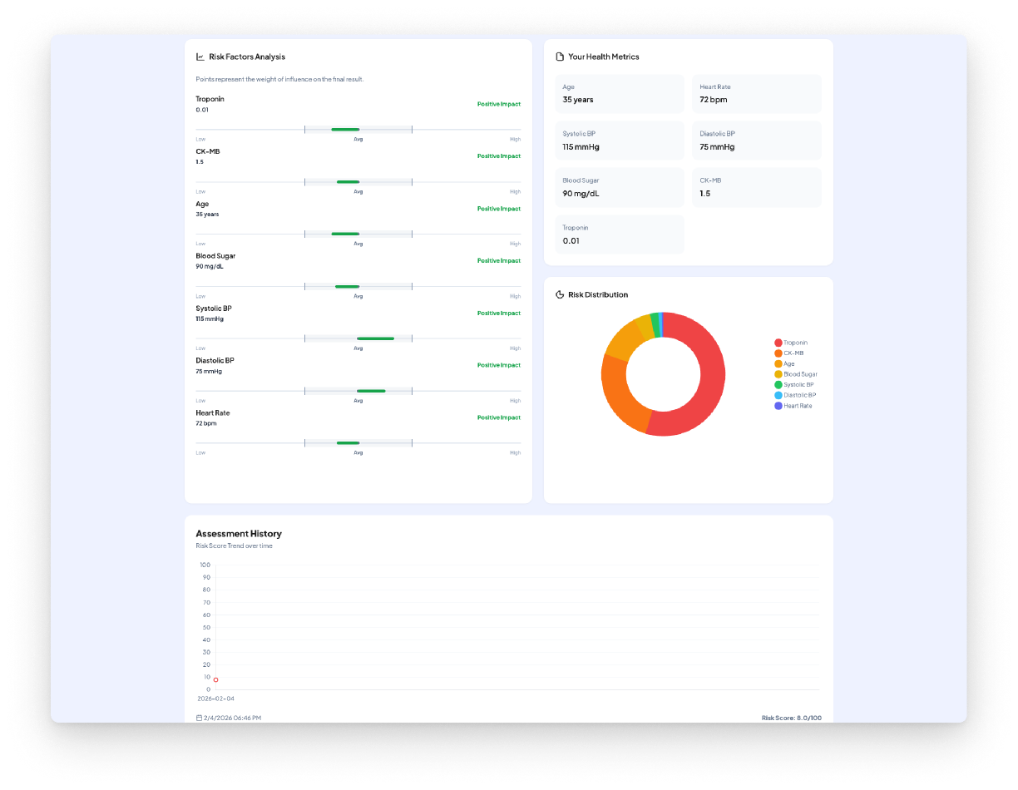
DEMO
Let’s see our website in action!

Slide 13

Q&A

